Slide 1

So You Want to Write a Book?
Writing, Publishing, Marketing & Protecting Your Work

Slide 2



Introduction
April Collins, Esq. : Author of Only the Strong Thrive and “Thrive” the Journal.
Kwoya Fagin Maples, M.F.A. : Author of Mend (Univ. Press of Kentucky, 2018)

Slide 3

You don’t have to have a clear idea to get started, but it helps to have a purpose!

Slide 4

Writing the Book: Methods for Generating Content & Editing
Determining your purpose for writing
How to actually get started
Companion texts
Setting writing goals

Slide 5

Perseverance & Writer’s Block
How do you persevere?
Writer’s Block
Editing
Knowing when the book is done
Beta Readers

Slide 6

Getting Your Book in Print: Traditional vs. Self-Publication
Self-Publication
Traditional Publication
Pros and Cons

Slide 7

Legally Protecting Your Work
Copyrighting
Trademarking
Hire IP Attorney

Slide 8

Prepping for your Book Launch
Knowing your target audience
Social Media Presence
How to use social media sites like Facebook, Instagram & Twitter
Blogging
Website

Slide 9
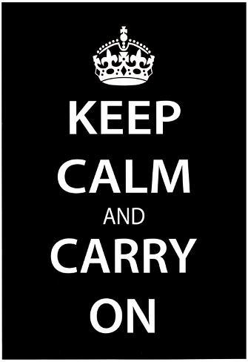
Ongoing Marketing Strategies
Amazon/Author Central Marketing
Word of Mouth
Giveaways
Maintaining Social Media Presence
Speaking engagements, readings & signings

Slide 10
Questions?
Feel free to contact us for additional information!
Kwoya Fagin Maples April H. Collins
kwoyafaginmaples.com author@onlythestrongthrive.com
@kwoyafaginmapleswriter (Facebook) @authoraprilhcollins (Facebook)
*Our books may be found on Amazon and wherever books are sold.

