Slide 1


TAKE A DEPOSITION LIKE A PRO
Leon Hampton, Associate, Beasley Allen Law Firm
Summer Wells, Associate, Serious Injury Law Group

Slide 2
What is a “Deposition”?
“Depositions are not only the most common form of discovery, but properly used, they are also the most effective weapon in the discovery arsenal.” – James L. Underwood
A Deposition is a legal proceeding in which an attorney questions a witness regarding his/her knowledge of an event(s).
Rule 30 of the Alabama Rules of Civil Procedure provides, “after commencement of the action, any party may take the testimony of any person, including a party, by deposition upon oral examination.

Slide 3
Reasons to Take a Deposition
To take an effective deposition, the examiner must know the goal of taking the deposition. There are several reasons to take a deposition. Below are common reasons for deposing a witness.
Gather evidence to prove your client’s claims
Preserve testimony
Better understand opposing party factual position on key issues
Commit a witness to his/ her version of the facts
To use as a fact-finding tool
Assess the credibility of key witnesses

Slide 4
Preparing for the Deposition “Give me six hours to chop down a tree, and I will spend the first four sharpening the axe.” –Abraham Lincoln
You should never “wing” a deposition.
To effectively prepare for a deposition, you must be more than familiar with the facts of your case.
Fully master your casefile.
Think about the evidence that you will need to prove each claim.
Identify the evidence that’s already in your client’s possession (i.e. recordings, video, emails, etc. including documents produced by the defendants)
Determine what testimony you expect to gain from each witness.

Slide 5

Preparing for the Deposition (continued)
Develop a thorough outline
Topical Outline v. Detailed Outline
Prepare exhibits
It’s important to make enough copies for opposing counsel(s), the deponent, and yourself
Make sure you have all of your exhibits, outlines, and copies prior to the deposition.
If possible, do an internet search of the deponent (i.e. Facebook, Twitter, Instagram, LinkedIn etc.)

Slide 6
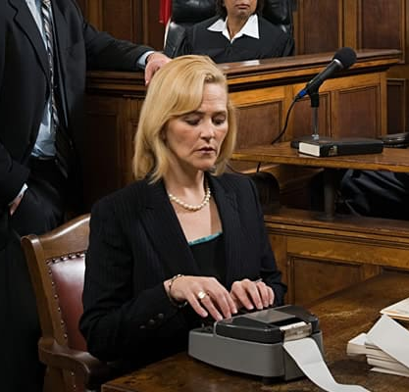
Preparing for the Deposition (Continued)
Make sure that you have made proper arrangements with the court reporter and videographer.
Make sure that the location of the deposition is reserved.
Identify who will attend the deposition.
Know the local rules of the court where the case is pending.

Slide 7
Taking the Deposition
Generally, preparing for the deposition should take longer than the deposition itself.
Once you have created your outline, don’t be afraid to go off script.
You must listen to the answer that you are provided to make sure 1) the answer was responsive to the question and 2) that the answer doesn't require a follow-up question.
The unscripted, unplanned follow-up question often provides the best gems.
At this stage of litigation, its important to explore many factual scenarios so that you can sufficiently pin the witness down to his/her version of the facts.
Avoid the temptation to only ask questions that are beneficial to your theory.

Slide 8
Taking the Deposition (Continued)
You want to know of hurtful testimony prior to trial.
Know the stipulations.
“usual stipulations” vary from attorney to attorney. Be sure that the attorneys are on the same page regarding stipulations, objections, scope of the deposition, and any other parameter that can save you from being interrupted in the middle of your deposition.
Generally, parties agree to limit objections to the form of the questions. However, make sure that the stipulations are clear and on the record.
Always make sure that the record is clear.
Particularly, on “key” issues always make sure that the questions and answers are clear.
Bring co-counsel or a paralegal to the deposition to make sure that the “key issues” were adequately explored and clearly examined.
The most important thing you will leave the deposition with is the transcript

Slide 9
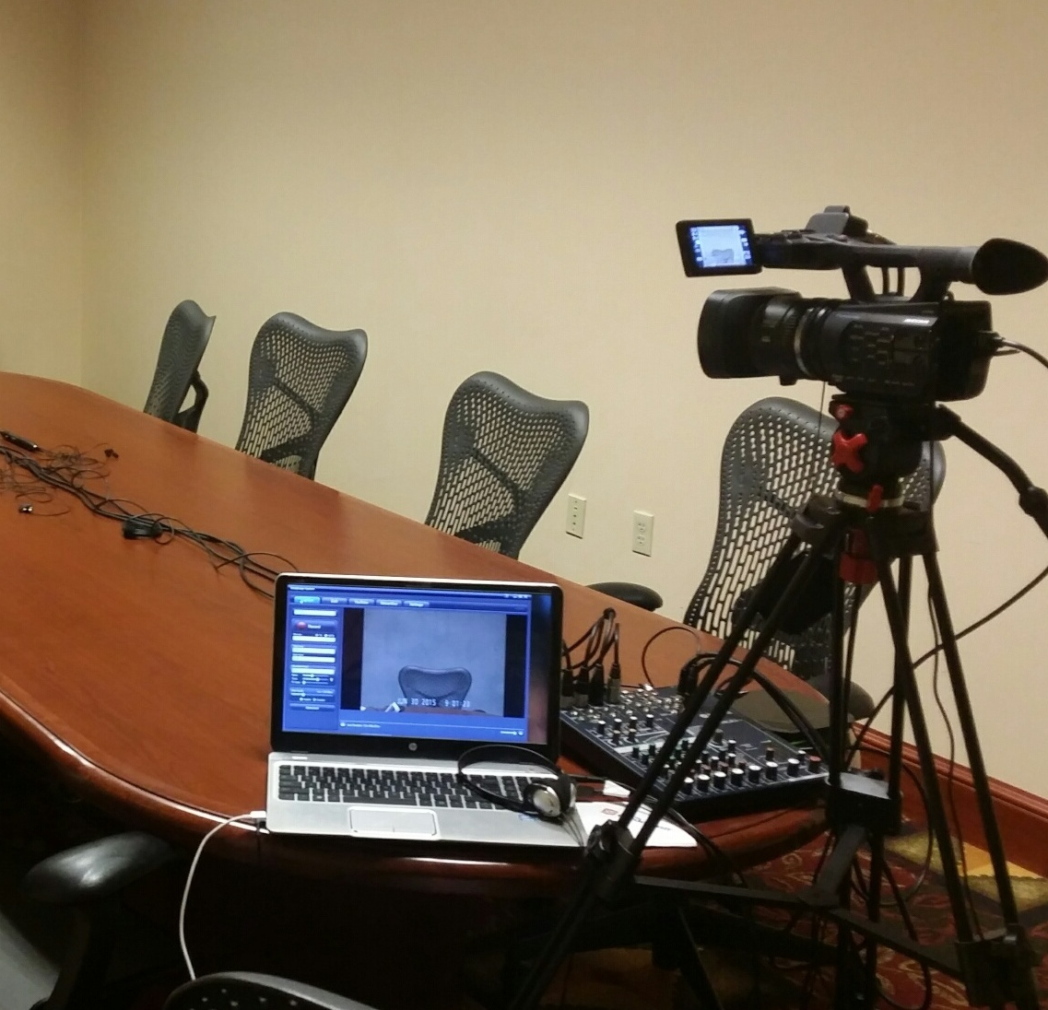
Video Depositions “Seeing something once is better than hearing about it a hundred times” –Lisa See
In a perfect world, all depositions would be videotaped. However, litigation costs prevent us from taping every deposition
In certain scenarios, videotaping a deposition is especially useful. If a witness is terminally ill, it’s a good idea to tape the witness, so the jury can have an appreciation for the witness’s condition and demeanor while answering the questions.
It’s equally helpful to videotape a Defendant’s 30(b)(6) Corporate Representative.
However, if you decide to videotape the deposition, you must notice the deposition as a video deposition.

Slide 10
Defending a Deposition
Preparation is essential to defending a deposition.
Many people have never been deposed. As such, you should make sure that your client is sufficiently prepared.
It’s important that the witness is more than familiar with the potential topics that will be covered.
Below are some additional tips to give to the deponent to prepare them for their deposition.
Only answer the question asked
Don’t speculate
Always be truthful
Always read a document before answering questions regarding the document
Take a break when needed
If you don’t understand the question, ask the examiner to clarify

Slide 11
Deposition “pitfalls” to avoid
Don’t allow opposing counsel to “throw you off of your game.”
Stay focused on the goal of the deposition.
Always thoroughly review the case file and the documents that are in the case.
Don’t attempt to wing it. It will not work.
Don’t forget to ask your client about the witness. Your client may have information about the witness that will help their case.
Always listen to the responses. You may get helpful information that you didn’t plan to obtain.
Don’t forget to read the transcript from your last deposition to avoid prior mistakes.

Slide 12
Thank you. Summer Wells, Serious Injury Law Group summer@seriouslawyers.com Leon Hampton, Beasley Allen Law Firm leon.Hampton@beasleyallen.com

